Slide 1
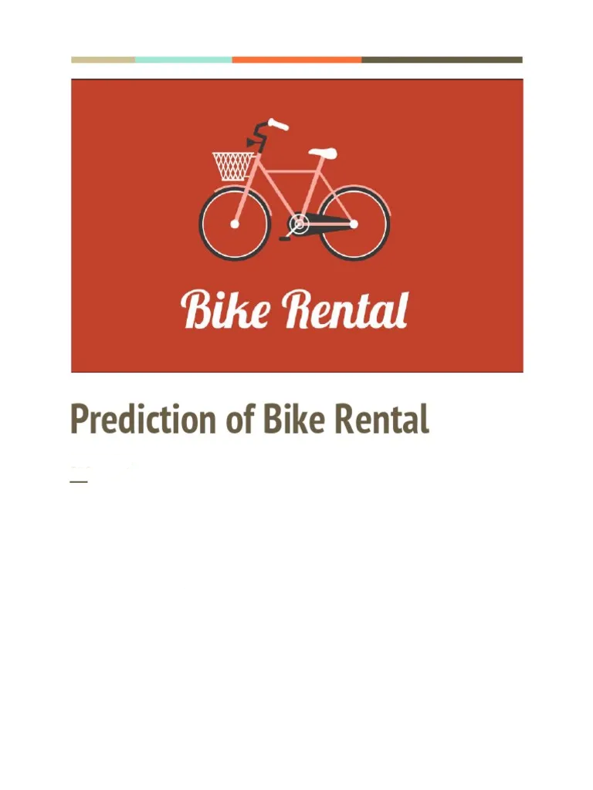

BIKE RENTAL PREDICTION
Bike sharing systems are a means of renting bicycles where the process of obtaining membership, rental, and bike return is automated via a network throughout a city.
PTID-CDS-MAY22-1315
- Ankita Das(anki.das23@gmail.com)
- Kavita Desai (kdarch14@gmail.com)
- Prasant Vijay Karn (prasantvkarn@gmail.com)

Slide 2
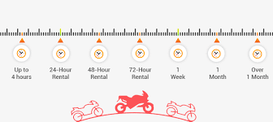
THE DATASET
- day.csv
- hour.csv

Slide 3
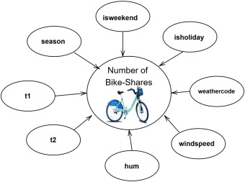
EDA and Insights of Data
Total number of Bike Renters: 3292679
• Total number of registered User: 2672662
• Registered User who actually Rented Bikes 81.17 %
• Total number of Non-Registered User: 620017
• Non-Registered User who actually Rented Bikes: 18.83 %
• Bike Rental per hour: 189
• Bike Rental per minute: 3
• There are all numerical variable only the date time is object type.

Slide 4
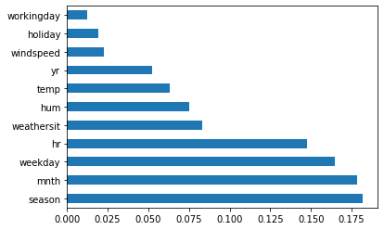
FEATURE ENGINEERING
Regression: Predicting the number of bikes rented based on environment and weather condition.

Slide 5
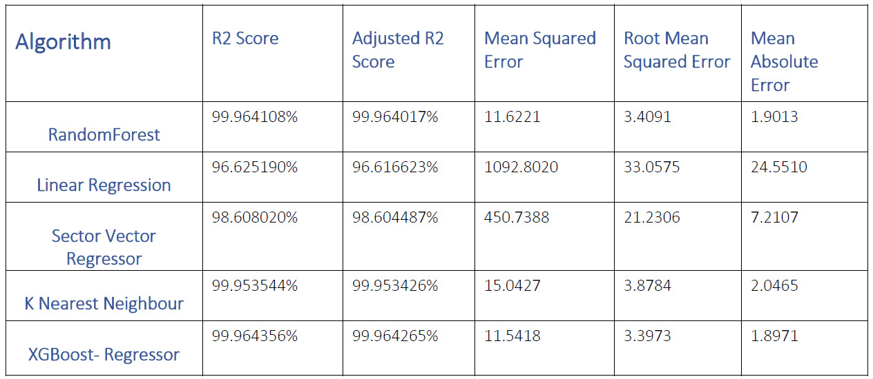
MODEL BUILDING and EVALUATION

Slide 6
THANK YOU

